Slide 1











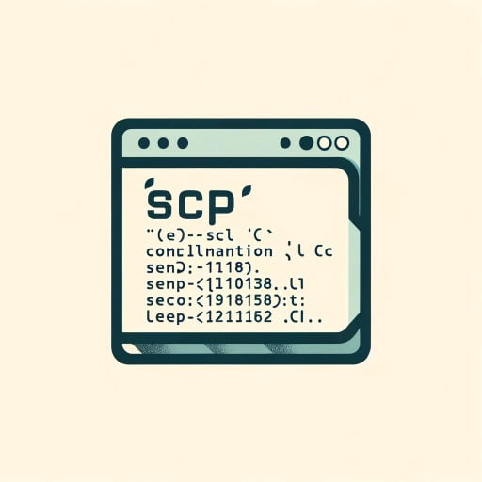




Finder App deployment steps
21st May 2024

Slide 2

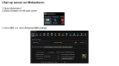
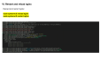
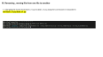
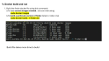
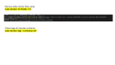
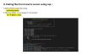
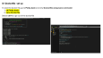
App deployment flow
Pulling file from local to server using scp
Dockerfile set up
Reload and restart nginx
Start
End
Deployment
Set up server on Mobaxterm
Renaming , moving file from one file to another
Docker build and run
Check docker ps and docker logs and check for Final app

Slide 3
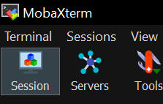
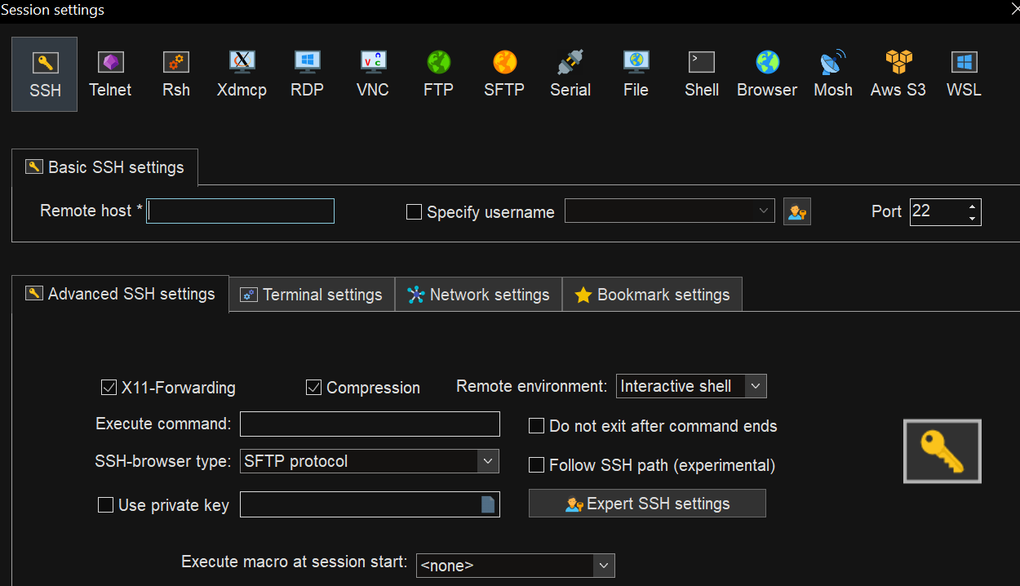
I.Set up server on Mobaxterm: 1.Open Mobaxterm 2.Select Session on left side corner
3.Select SSH and select Advanced SSH settings

Slide 4
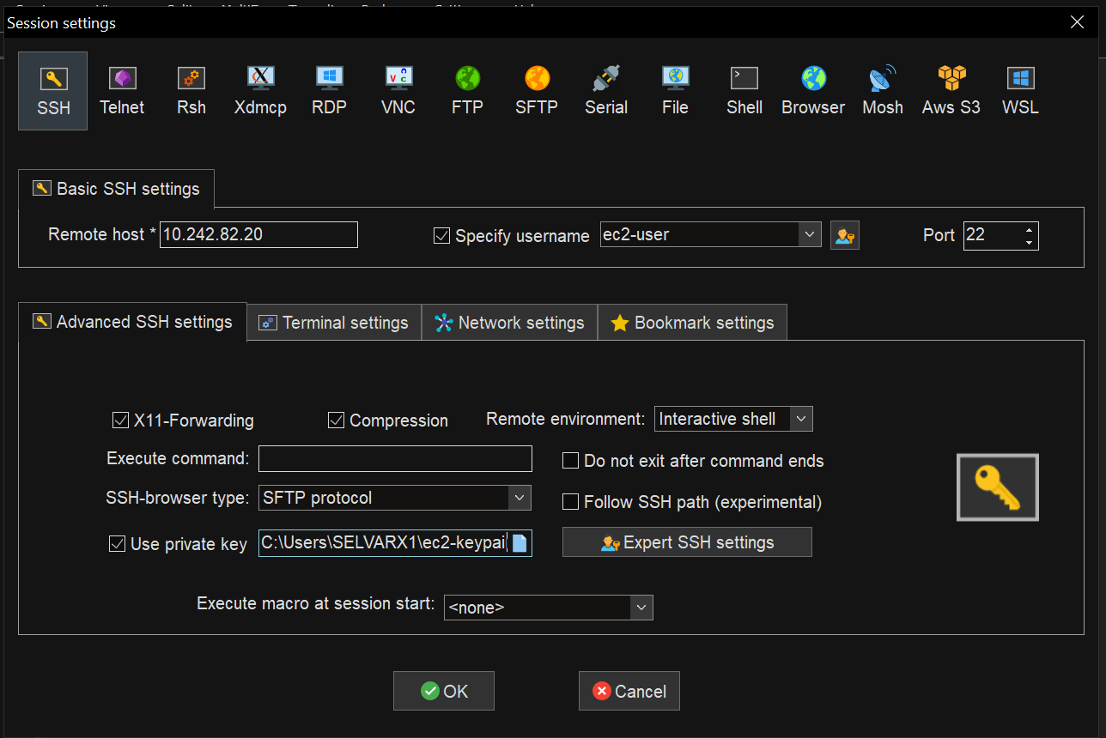
4.Give the server ip on remote host and select specify user name and by default give ec2-user 5.Select Use private key and upload the keypair file (ec2-Keypair.pem)

Slide 5
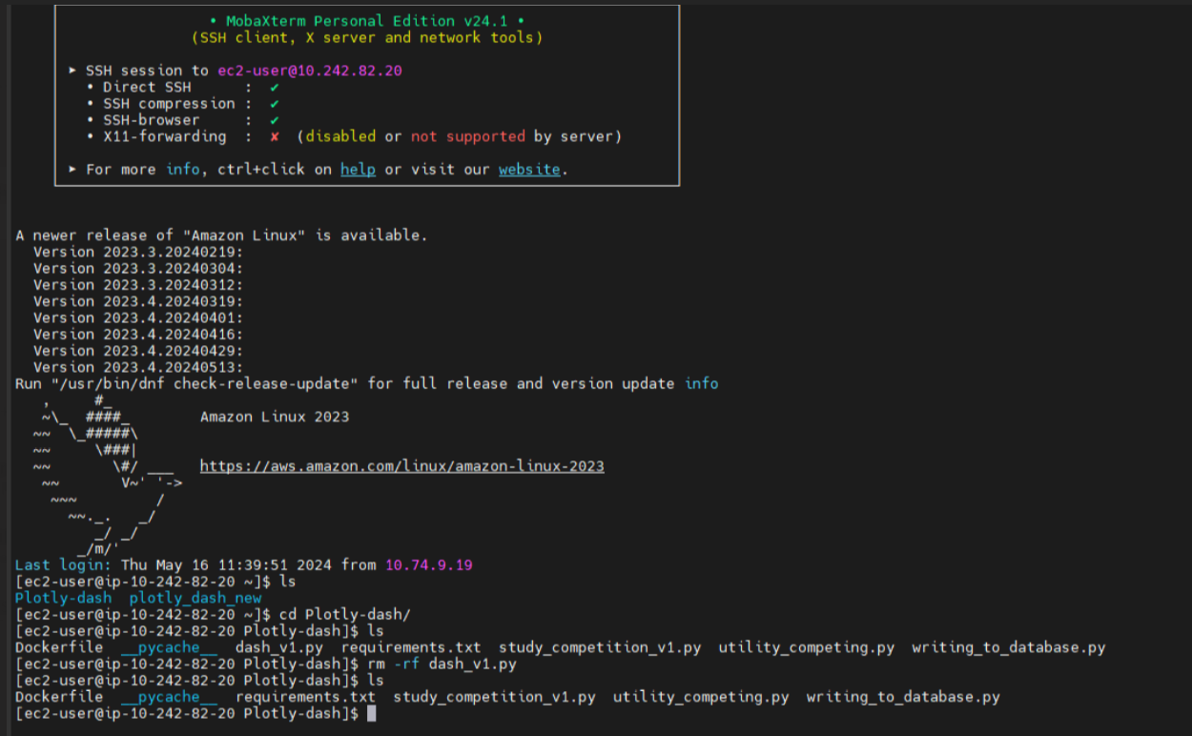
II. Pulling file from local to server using scp : 1.Select Plotly-dash file using: cd Plotly-dash/ 2. Remove dash_v1.py using rm command: rm -rf dash_v1.py

Slide 6
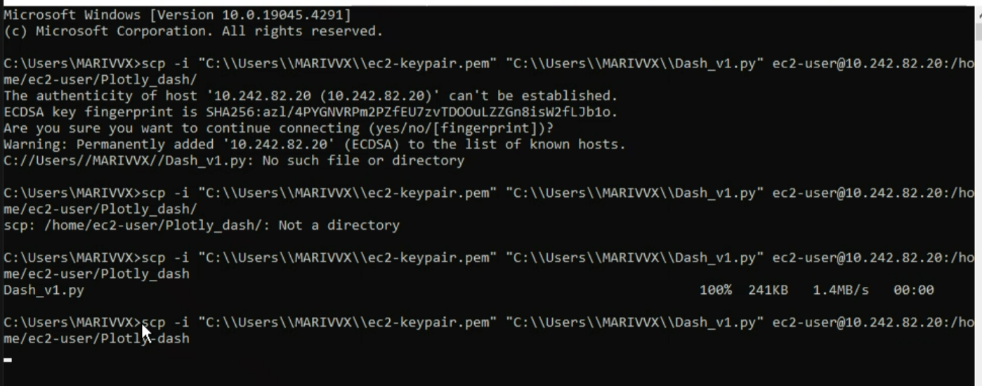
3. Using scp command from local to server in command prompt: scp -i "C:\\Users\\MARIVVX\\ec2-keypair.pem" "C:\\Users\\ MARIVVX \\Dash_v1.py" ec2-user@10.242.82.20:/home/ec2-user /Plotly-dash For the first time it prompts a message for connecting type yes to proceed 4. Now the file which we want to upload was successfully uploaded on the server

Slide 7
III. Renaming , moving file from one file to another
1. Changing file name from Dash_v1.py to dash_v1.py using the command in mobaxterm: mv Dash_v1.py dash_v1.py

Slide 8
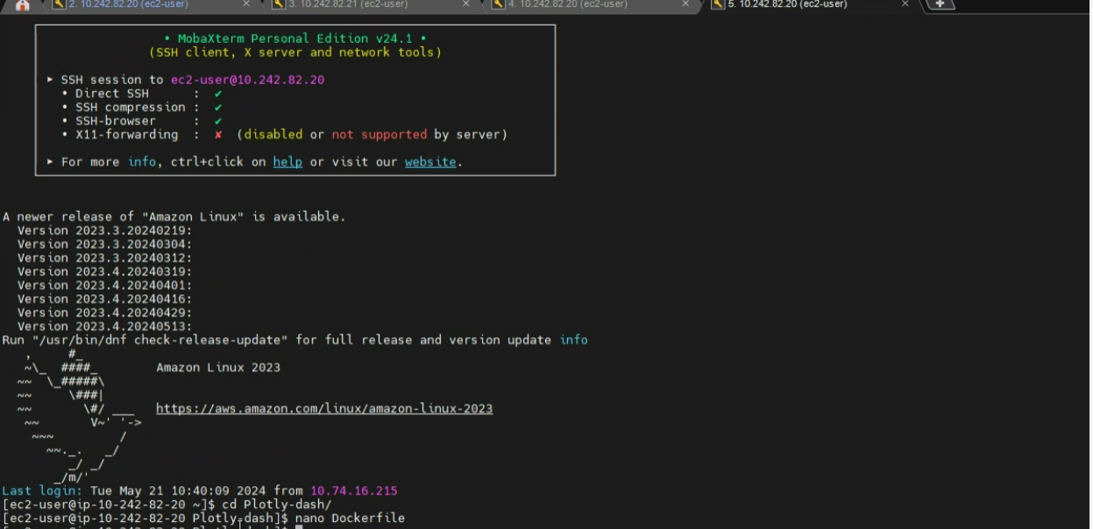
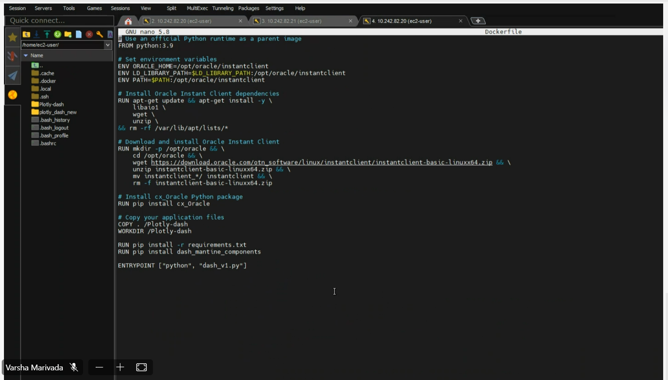
To view the docker file, go to Plotly-dash and view Dockerfile using nano command: 1. cd Plotly-dash/ 2. nano Dockerfile
IV. Dockerfile set up
Select ctrl+x to go out of the dockerfile

Slide 9
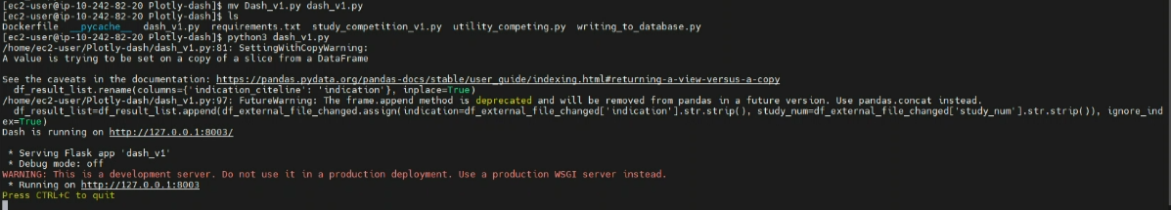
Test the dash_v1.py ap using :
python3 dash_v1.py

Slide 10
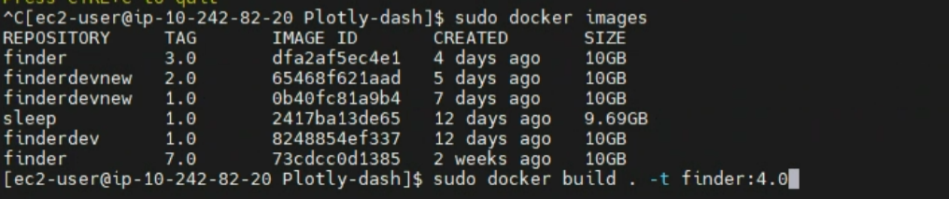
V. Docker build and run
1. Build the finder docker file using this command: a.To view current images created , one can view using: sudo docker images b.To build a particular version of finder (latest or older one) sudo docker build . -t finder:4.0
Build file takes more time to build

Slide 11
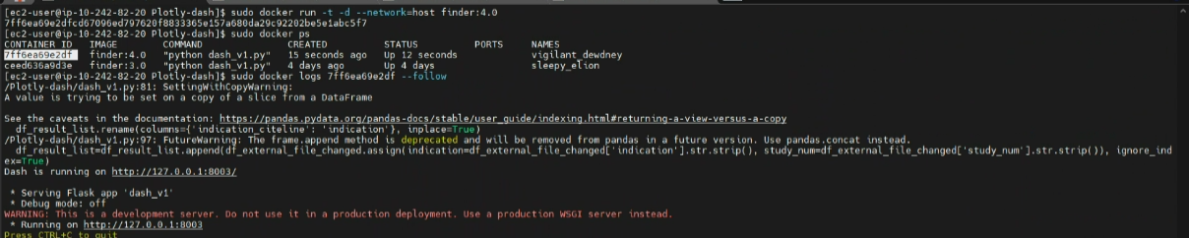
Run docker build file using : sudo docker run -t -d –network=host finder:4.0

Slide 12
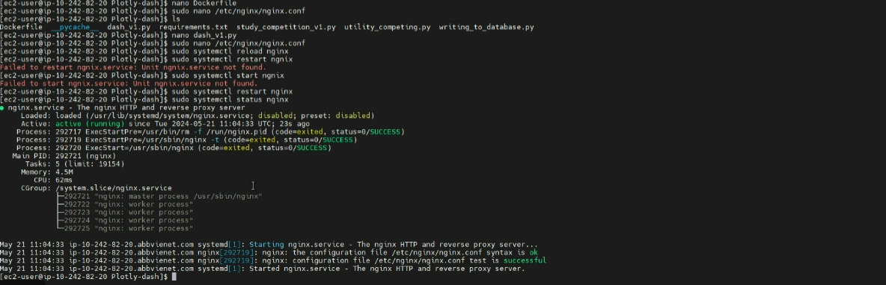
VI. Restart and reload nginx
Reload and restart nginx: sudo systemctl reload nginx sudo systemctl restart nginx

Slide 13
Remove older docker files using: sudo docker rmi finder: 7.0
Check logs of a docker container: sudo docker logs <container-id>

Slide 14


